Slide 1
User Interaction and Navigation
Android Developer Fundamentals
Lesson 4

Slide 2
4.1 User Input Controls

Slide 3
Contents
User Interaction
Focus
Text input and keyboards
Radio Buttons and Checkboxes
Making Choices
dialogs, spinners and pickers
Recognizing gestures

Slide 4
User Interaction

Slide 5

Users expect to interact with apps
Clicking, pressing, talking, typing, and listening
Using user input controls such buttons, menus, keyboards, text boxes, and a microphone
Navigating between activities
User Input Controls
This work is licensed under a Creative Commons Attribution-NonCommercial 4.0 International License
Android Developer Fundamentals

Slide 6
User interaction design
Important to be obvious, easy, and consistent:
Think about how users will use your app
Minimize steps
Use UI elements that are easy to access, understand, use
Follow Android best practices
Meet user's expectations
User Input Controls
This work is licensed under a Creative Commons Attribution-NonCommercial 4.0 International License
Android Developer Fundamentals

Slide 7
Input Controls

Slide 8
Ways to get input from the user
Free form
Text and voice input
Actions
Buttons
Contextual menus
Gestures
Dialogs
Constrained choices
Pickers
Checkboxes
Radio buttons
Toggle buttons
Spinners

Slide 9
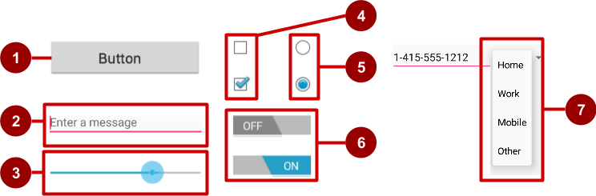
Examples of user input controls
Button
Text field
Seek bar
Checkboxes
Radio buttons
Toggle
Spinner

Slide 10
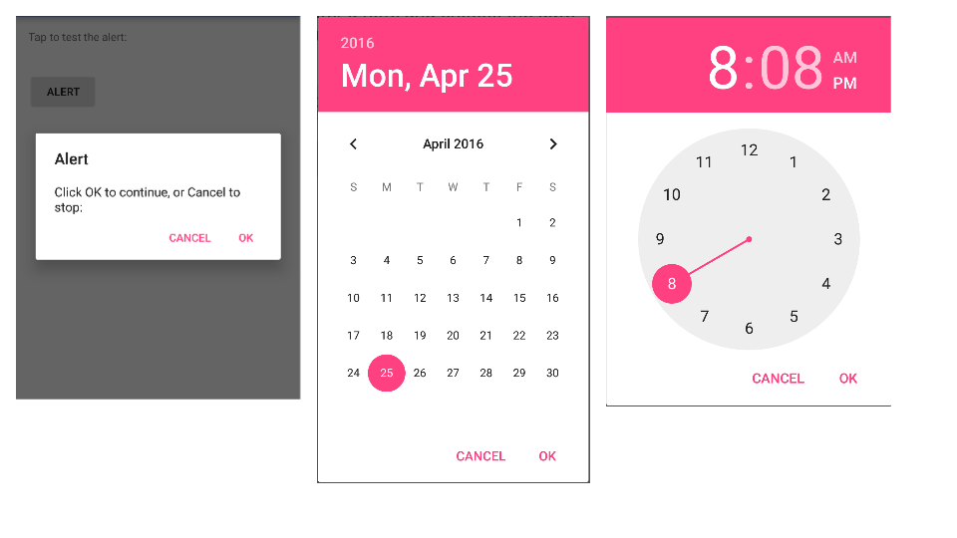
Alert dialog, date picker, time picker

Slide 11
View is base class for input controls
The View class is the basic building block for all UI components, including input controls
View is the base class for classes that provide interactive UI components
View provides basic interaction through android:onClick

Slide 12
Focus

Slide 13
Focus
The view that receives user input has "Focus"
Only one view can have focus
Focus makes it unambiguous which view gets the input
Focus is assigned by
User tapping a view
App guiding the user from one text input control to the next using the Return, Tab, or arrow keys
Calling requestFocus() on any view that is focusable

Slide 14
Clickable versus focusable
Clickable—View can respond to being clicked or tapped
Focusable—View can gain focus to accept input
Input controls such as keyboards send input to the view that has focus

Slide 15
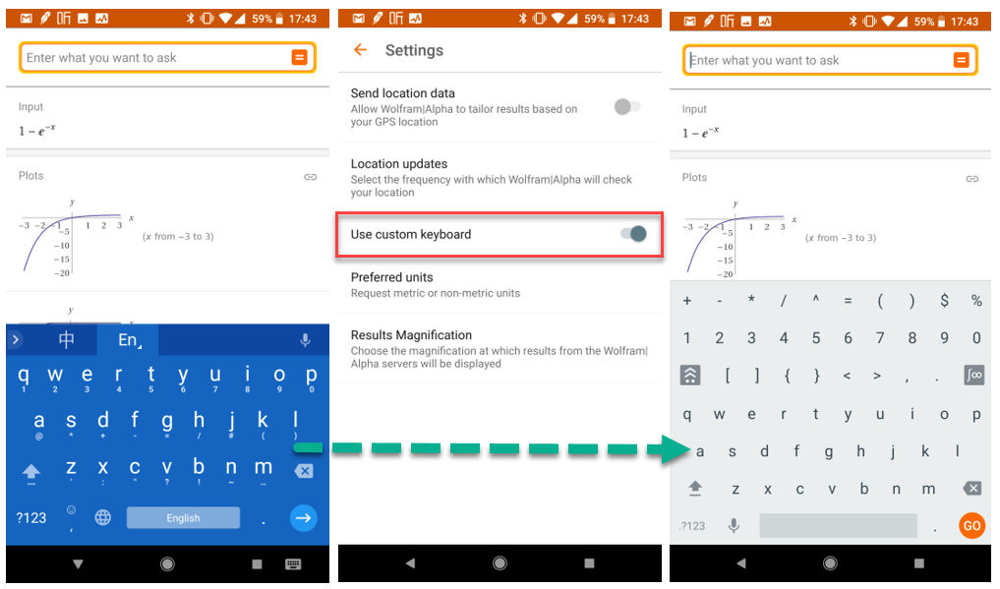
Focus

Slide 16
Which View gets focus next?
Topmost view under the touch
After user submits input, focus moves to nearest neighbor—priority is left to right, top to bottom
Focus can change when user interacts with a directional control

Slide 17
Guiding users
Visually indicate which view has focus so users knows where their input goes
Visually indicate which views can have focus helps users navigate through flow
Predictable and logical—no surprises!

Slide 18
Guiding focus
Arrange input controls in a layout from left to right and top to bottom in the order you want focus assigned
Place input controls inside a view group in your layout
Specify ordering in XML
android:id="@+id/top"
android:focusable="true"
android:nextFocusDown="@+id/bottom"

Slide 19
Set focus explicitly
Use methods of the View class to set focus
setFocusable() sets whether a view can have focus
requestFocus() gives focus to a specific view
setOnFocusChangeListener() sets listener for when view gains or loses focus
onFocusChanged() called when focus on a view changes

Slide 20
Find the view with focus
Activity.getCurrentFocus()
ViewGroup.getFocusedChild()

Slide 21
Text Input

Slide 22
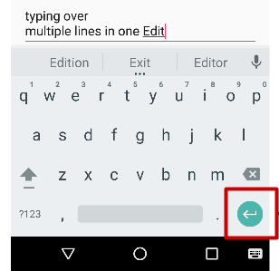
EditText
EditText class
Multiple lines of input
Characters, numbers, and symbols
Spelling correction
Tapping the Return (Enter) key starts a new line
Customizable
"Action" key

Slide 23
Getting text
Get the EditText object for the EditText view
EditText simpleEditText = (EditText) findViewById(R.id.edit_simple);
Retrieve the CharSequence and convert it to a string
String strValue = simpleEditText.getText().toString();

Slide 24
Input types
Common input types
textShortMessage—Limit input to 1 line
textCapSentences—Set keyboard to caps at beginning of sentences
textAutoCorrect—Enable autocorrecting
textPassword—Conceal typed characters
textEmailAddress—Show an @ sign on the keyboard
phone—numeric keyboard for phone numbers
android:inputType="phone"
android:inputType="textAutoCorrect|textCapSentences"

Slide 25
Buttons

Slide 26
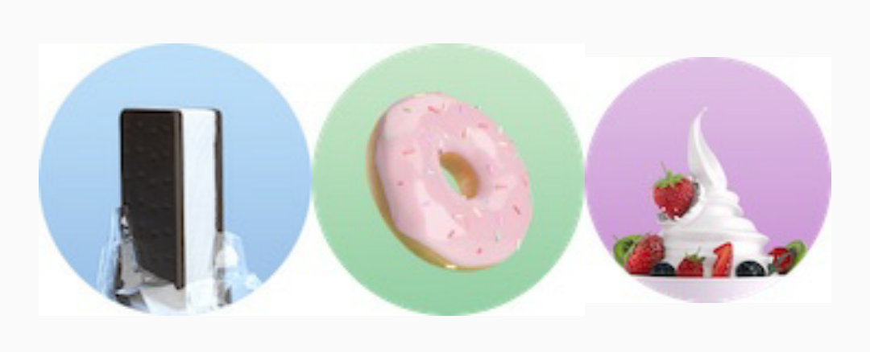

Button
View that responds to clicking or pressing
Usually text or visuals indicate what will happen when it is pressed
Views: Button > ToggleButton, ImageView > FloatingActionButton (FAB)
State: normal, focused, disabled, pressed, on/off
Visuals: raised, flat, clipart, images, text

Slide 27
Responding to button taps
In your code: Use OnClickListener event listener.
In XML: use android:onClick attribute in the XML layout:
<Button
android:id="@+id/button_send"
android:layout_width="wrap_content"
android:layout_height="wrap_content"
android:text="@string/button_send"
android:onClick="sendMessage" />
android:onClick
Notes:
A click event occurs when the user taps or clicks a button, or an image used as a button. The object notifies an event listener called OnClickListener, which is an interface in the View class. You can use the listener to respond to a click event.
Android Studio provides a shortcut for setting up an OnClickListener for the clickable object in your Activity code, and for assigning a callback method: use the android:onClick attribute with the clickable object’s element in the XML layout. For example:
<Button
android:id="@+id/button_send"
android:layout_width="wrap_content"
android:layout_height="wrap_content"
android:text="@string/button_send"
android:onClick="sendMessage" />
In this case, when a user clicks the button, the Android system calls the Activity’s sendMessage() method.

Slide 28
Setting listener with onClick callback
Button button = (Button) findViewById(R.id.button);
button.setOnClickListener(new View.OnClickListener() {
public void onClick(View v) {
// Do something in response to button click
}
});

Slide 29
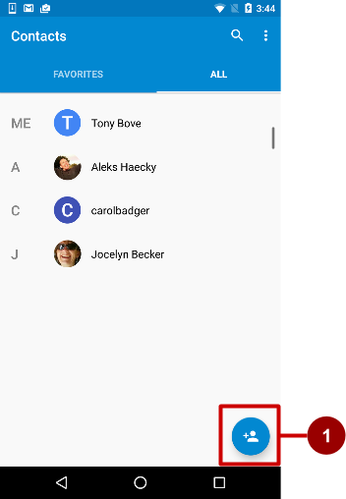
Floating Action Buttons (FAB)
Raised, circular, floats above layout
Primary or "promoted" action for a screen
One per screen
For example:
Add Contact button in Contacts app

Slide 30
Using FABs
Add design support library to build.gradle
compile 'com.android.support:design:a.b.c'
Layout
<android.support.design.widget.FloatingActionButton
android:id="@+id/fab"
android:layout_gravity="bottom|end"
android:layout_margin="@dimen/fab_margin"
android:src="@drawable/ic_fab_chat_button_white"
.../>

Slide 31
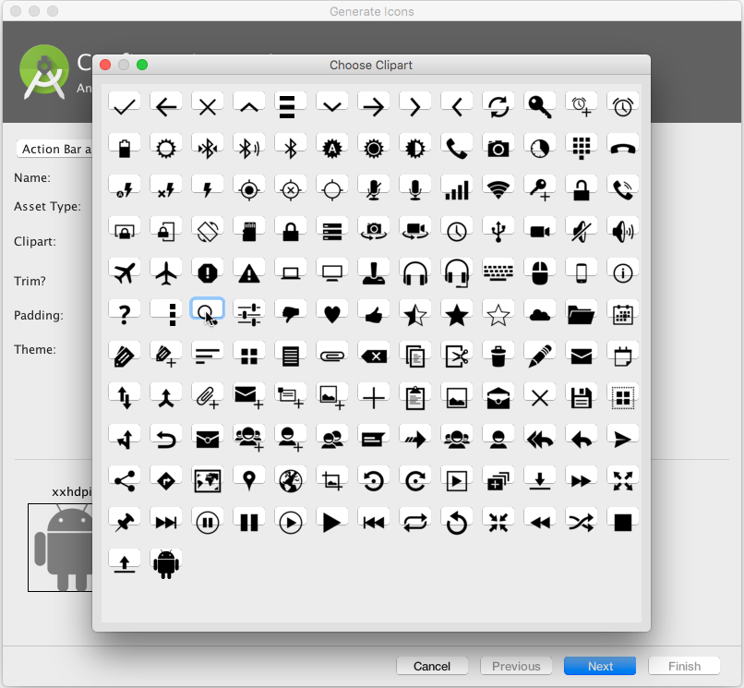
Button image assets
Right-click app/res/drawable
Choose New > Image Asset
Choose Action Bar and Tab Items from drop down menu
Click the Clipart: image (the Android logo)
Experiment:
Choose New > Vector Asset

Slide 32
END
Noting Great Ever Comes, Without Sacrifice

